Slide 1
Course : Computational Biology
Effective Period : June 2022
Basic Principles of Biology

Slide 2
Introduction Basic Principles of Biology

Slide 3
Content
Content
System Biology
Unifying Themes in Biology
Darwin and Evolution

Slide 4
THE SCIENCE OF LIFE
Biology is a subject of enormous scope, and news reports reveal exciting new biological discoveries being made every day.
Biology unifies much of natural science
The study of biology is a point of convergence for the information and tools from all of the natural sciences.
Biological systems are the most complex chemical systems on Earth, and their many functions are both determined and constrained by the principles of chemistry & physics.

Slide 5
THE SCIENCE OF LIFE
Systems biology: is an approach that attempts to model the dynamic behavior of whole biological systems based on a study of the interactions among the system’s parts.
Life defies simple definition
In its broadest sense, biology is the study of living things The Science of Life.
Seven Characteristics Shared by Living Systems:
Cellular organization: All organisms consist of one or more cells. Often too tiny to see, cells carry out the basic activities of living. Each cell is bounded by a membrane that separates it from its surroundings.

Slide 6
THE SCIENCE OF LIFE
Characteristics Shared by Living Systems:
Ordered complexity: All living things are both complex and highly ordered.
Sensitivity: All organisms respond to stimuli. Plants grow toward a source of light, and the pupils of your eyes dilate when you walk into a dark room.
Growth, development, and reproduction: All organisms are capable of growing and reproducing, and they all possess hereditary molecules that are passed to their offspring, ensuring that the offspring are of the same species.

Slide 7
THE SCIENCE OF LIFE
Characteristics Shared by Living Systems:
Energy utilization: All organisms take in energy and use it to perform many kinds of work.
Homeostasis: All organisms maintain relatively constant internal conditions that are different from their environment, a process called homeostasis.
Evolutionary adaptation: All organisms interact with other organisms and the nonliving environment in ways that influence their survival, and as a consequence, organisms evolve adaptations to their environments.

Slide 8
THE SCIENCE OF LIFE
LIVING SYSTEMS SHOW HIERARCHICAL ORGANIZATION
The organization of the biological world is hierarchical—that
is, each level builds on the level below it:
The Cellular Level. At the cellular level, atoms, the fundamental elements of matter, are joined together into clusters called molecules.
Complex biological molecules are assembled into tiny structures called organelles within membrane-bounded units we call cells.
Bacteria are single cells, for example. All animals and plants, as well as most fungi and algae, are multi cellular composed of more than one cell.

Slide 9
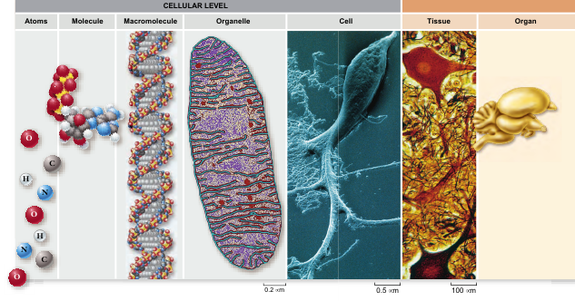
THE SCIENCE OF LIFE
LIVING SYSTEMS SHOW HIERARCHICAL ORGANIZATION

Slide 10
THE SCIENCE OF LIFE
LIVING SYSTEMS SHOW HIERARCHICAL ORGANIZATION
The Organismal Level. Cells in complex multicellular organisms exhibit three levels of organization.
The most basic level is that of tissues, which are groups of similar cells that act as a functional unit.
Tissues, in turn, are grouped into organs—body structures composed of several different tissues that act as a structural and functional unit.
Your brain is an organ composed of nerve cells and a variety of associated tissues that form protective coverings & contribute blood. At the third level of organization, organs are grouped into organ systems.

Slide 11
THE SCIENCE OF LIFE
LIVING SYSTEMS SHOW HIERARCHICAL ORGANIZATION
The Populational Level. Individual organisms can be categorized into several hierarchical levels within the living world. The most basic of these is the population-a group of organisms of the same species living in the same place.
All populations of a particular kind of organism together form a species, its members similar in appearance and able to interbreed.
At a higher level of biological organization, a biological community consists of all the populations of different species living together in one place.

Slide 12
THE SCIENCE OF LIFE
LIVING SYSTEMS SHOW HIERARCHICAL ORGANIZATION
Ecosystem Level. At the highest tier of biological organization, a biological community and the physical habitat within which it lives together constitute an ecological system, or ecosystem.
For example, the soil, water, and atmosphere of a mountain ecosystem interact with the biological community of a mountain meadow in many important ways.
The Biosphere. The entire planet can be thought of as an ecosystem that we call the biosphere.

Slide 13
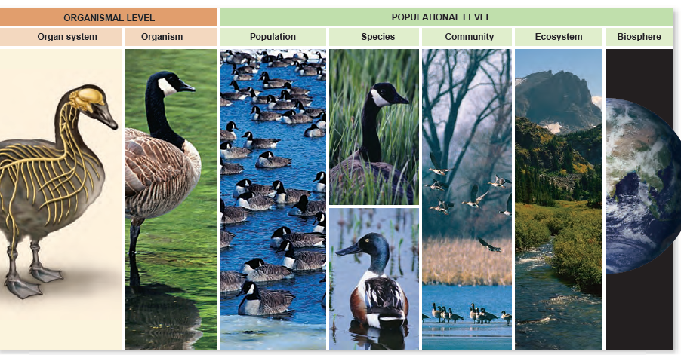

Slide 14
THE NATURE OF SCIENCE
Science uses both deductive and inductive reasoning
Deductive reasoning: Deductive reasoning applies general principles to predict specific results.
Inductive reasoning In inductive reasoning, the logic flows in the opposite direction, from the specific to the general. Inductive reasoning uses specific observations to construct general scientific principles. Inductive reasoning leads to generalizations that can then be tested.

Slide 15
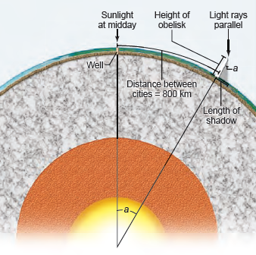
THE NATURE OF SCIENCE
Deductive reasoning: how Eratosthenes estimated the circumference of the earth using deductive reasoning.
On a day when sunlight shone straight down a deep well at Syene in Egypt, Eratosthenes measured the length of the shadow cast by a tall obelisk in the city of Alexandria, about 800 kilometers (km) away.
The shadow’s length and the obelisk’s height formed two sides of a triangle.
If angle a is 0 of a circle, then the distance between the obelisk (in Alexandria) and the well (in Syene) must be equal to 0 the circumference of the Earth.
Eratosthenes had heard that it was a 50-day camel trip from Alexandria to Syene.
Eratosthenes thus deduced the circumference of the Earth to be 50 × 925 = 46,250 km

Slide 16
INDUCTIVE REASONING:
THE NATURE OF SCIENCE
For example: if poodles have hair, and terriers have hair, and every dog that you observe has hair, then you may conclude that all dogs have hair.
For an example from modern biology is the role of homeobox genes in development: Studies in the fruit fly, Drosophila melanogaster, identified genes that could cause dramatic changes in developmental fate, such as a leg appearing in the place of an antenna.

Slide 17
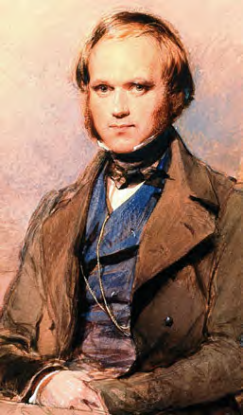
AN EXAMPLE OF SCIENTIFIC INQUIRY:
DARWIN AND EVOLUTION
Charles Robert Darwin (1809–1882; figure 1.5) was an English naturalist who, after 30 years of study and observation, wrote one of the most famous and influential books of all time.
Darwin’s theory of evolution explains and describes how organisms on Earth have changed over time and acquired a diversity of new forms.

Slide 18
UNIFYING THEMES IN BIOLOGY
Cell theory describes the organization of living systems.
The cell is the basic unit of life and is the foundation for understanding growth and reproduction in all organisms.
The molecular basis of inheritance explains the continuity of life.
Hereditary information, encoded in genes found in the DNA molecule, is passed on from one generation to the next.
The relationship between structure and function underlies living systems.
The function of macromolecules and their complexes is dictated by and dependent on their structure. Similarity of structure and function from one life form to another may indicate an evolutionary relationship.

Slide 19
UNIFYING THEMES IN BIOLOGY
Evolutionary conservation explains the unity of living systems.
The underlying similarities in biochemistry and genetics support the contention that all life evolved from a single source.
Cells are information-processing systems.
Cells can sense and respond to environmental changes through proteins located on their cell membranes. Differential expression of stored genetic information is the basis for different cell types.
Living systems exist in a nonequilibrium state.
Organisms are open systems that need a constant supply of energy to maintain their stable nonequilibrium state. Living things are able to self-organize, creating levels of complexity that may exhibit emergent properties.

Slide 20
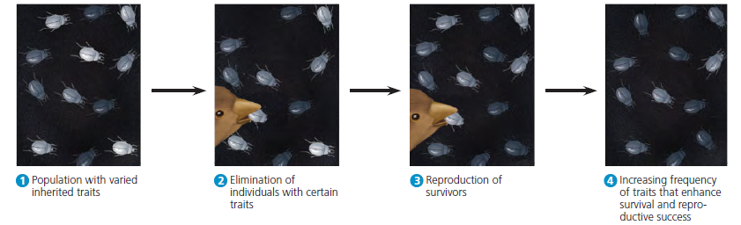
Darwin called this mechanism of evolutionary adaptation natural selection because the natural environment “selects” for the propagation of certain traits among naturally occurring variant traits in the population.
Figure Natural selection. This imaginary beetle population has colonized a locale where the soil has been blackened by a recent brush fire. Initially, the population varies extensively in the inherited coloration of the individuals, from very light gray to charcoal. For hungry birds that prey on the beetles, it is easiest to spot the beetles that are lightest in color.

Slide 21
The Building Blocks of Life

Slide 22
Content
Content
Water and Life
Carbon and Molecular Diversity
Structure and Large Biological Molecules

Slide 23
Water: A Vital Compound
Water’s structure facilitates hydrogen bonding.
Hydrogen bonds are weak interactions between a partially positive H in one molecule and a partially negative O in another molecule
Water’s structure facilitates hydrogen bonding:
Water has a simple molecular structure, consisting of an oxygen atom bound to two hydrogen atoms by two single covalent Bonds
Hydrogen bonds are weak interactions between a partially positive H in one molecule and a partially negative O in another molecule (see figure).

Slide 24
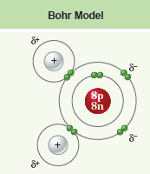
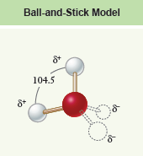
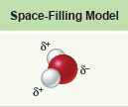
Water: A Vital Compound

Slide 25
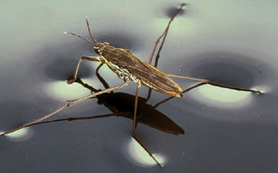
Water: A Vital Compound
Water molecules are cohesive.
Cohesion is the tendency of water molecules to adhere to one another due to hydrogen bonding. The cohesion of water is responsible for its surface tension.
Fig. Cohesion Some insects, such as this water strider, literally walk on water.

Slide 26
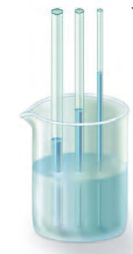
Water: A Vital Compound
Water molecules are adhesive.
Adhesion occurs when water molecules adhere to other polar molecules. Capillary action results from water’s adhesion to the sides of narrow tubes, combined with its cohesion.
Fig. Adhesion. Capillary action causes the water within a narrow tube to rise above the surrounding water level

Slide 27
Properties of Water
Water’s high specific heat helps maintain temperature.
The specific heat of water is high because it takes a considerable amount of energy to disrupt hydrogen bonds.
Water’s high heat of vaporization facilitates cooling.
Breaking hydrogen bonds to turn liquid water into vapor takes alot of energy. Many organisms lose excess heat through evaporative cooling, such as sweating.
Solid water is less dense than liquid water.
Hydrogen bonds are spaced farther apart in the solid phase of water than in the liquid phase. As a result, ice floats.

Slide 28
Properties of Water
The solvent properties of water help move ions and polar molecules
Water’s polarity makes it a good solvent for polar substances and ions.
Polar molecules or portions of molecules are attracted to water (hydrophilic).
Molecules that are nonpolar are repelled by water (hydrophobic). Water makes nonpolar molecules clump together.
The tendency of nonpolar molecules to aggregate in water is known as hydrophobic exclusion

Slide 29
Properties of Water
The solvent properties of water help move ions and polar molecules.
Water’s polarity makes it a good solvent for polar substances and ions. Polar molecules or portions of molecules are attracted to water (hydrophilic). Molecules that are nonpolar are repelled by water (hydrophobic). Water makes nonpolar molecules clump together.
Water organizes nonpolar molecules.
Nonpolar molecules will aggregate to avoid water. This maximizes the hydrogen bonds that water can make. This hydrophobic exclusion can affect the structure of DNA, proteins and biological membranes.

Slide 30

Properties of Water
Water can form ions.
Water dissociates into H⁺ and OH–. The concentration of H⁺, shown as [H⁺], in pure water is 10–7 mol/L.
The rest of the dissociated water molecule, which has retained the shared electron from the covalent bond, is negatively charged and forms a hydroxide ion, OH–. This process of spontaneous ion formation is called ionization:

Slide 31
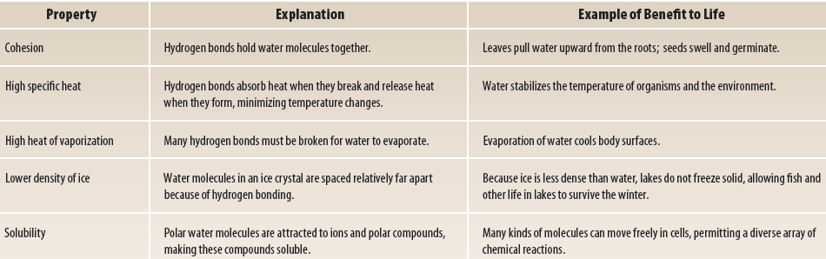
Properties of Water

Slide 32
Acid and Bases
The pH scale measures hydrogen ion concentration
pH is defined as the negative logarithm of [H⁺]. Pure water has a pH of 7. A difference of 1 pH unit means a 10-fold change in [H⁺]. Acids have a greater [H⁺] and therefore a lower pH; bases have a lower [H⁺] and therefore a higher pH.
Buffers help stabilize pH.
Carbon dioxide and water react reversibly to form carbonic acid. A buffer resists changes in pH by absorbing or releasing H⁺. The key buffer in the human blood is the carbonic acid/bicarbonate pair.

Slide 33
Acid and Bases
Acids
Any substance that dissociates in water to increase the [H⁺] (and lower the pH) is called an acid. The stronger an acid is, the more hydrogen ions it produces and the lower its pH. For example, hydrochloric acid (HCl), which is abundant in your stomach, ionizes completely in water.
Bases
A substance that combines with H⁺ when dissolved in water, and thus lowers the [H⁺], is called a base. Therefore, basic (or alkaline) solutions have pH values above 7. Very strong bases, such as sodium hydroxide (NaOH), have pH values of 12 or more.

Slide 34
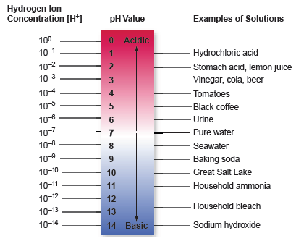
Acid and Bases
Figure 1.6 The pH scale. The pH value of a solution indicates its concentration of hydrogen ions. Solutions with a pH less than 7 are acidic, whereas those with a pH greater than 7 are basic.

Slide 35
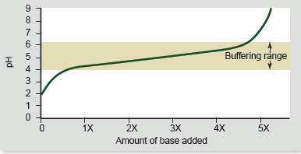
Acid and Bases
A buffer is a substance that resists changes in pH. Buffers
act by releasing hydrogen ions when a base is added and absorbing hydrogen ions when acid is added, with the overall effect of keeping [H+] relatively constant.
Figure 13. Buffers minimize changes in pH. Adding a base to a solution neutralizes some of the acid present, and so raises the pH.

Slide 36
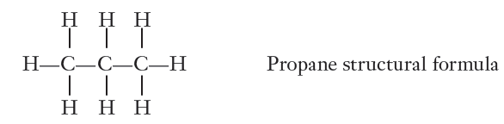
Carbon: The Framework of Biological Molecules
Carbon, the backbone of all biological molecules, can form four covalent bonds and make long chains.
Hydrocarbons consist of carbon and hydrogen, and their bonds store considerable energy.
For example, is rich in hydrocarbons, and propane gas, another hydrocarbon, consists of a chain of three carbon atoms, with eight hydrogen atoms bound to it. Its structural formula is

Slide 37
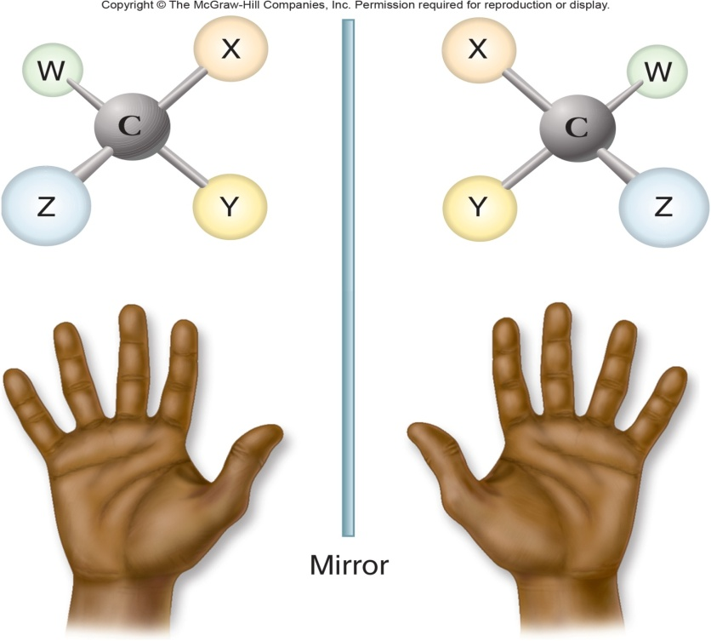
Carbon: The Framework of Biological Molecules
Isomers
Molecules with the same molecular or empirical formula
  Structural isomers
  Stereoisomers - differ in how groups attached
Enantiomers
  mirror image molecules
  chiral
  D-sugars and L-amino acids

Slide 38
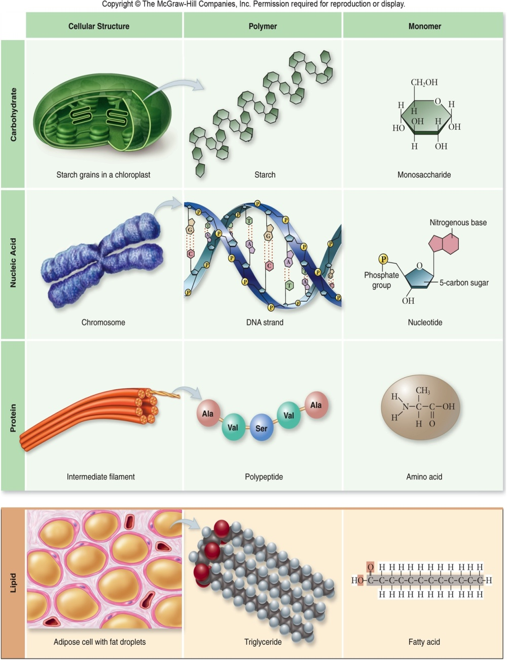
Carbon: The Framework of Biological Molecules
Macromolecules
Polymer – built by linking monomers
Monomer – small, similar chemical subunits
Three things to keep track of in all four macromolecules
  What is the Monomer
  What is the Polymer
  What is Bond

Slide 39
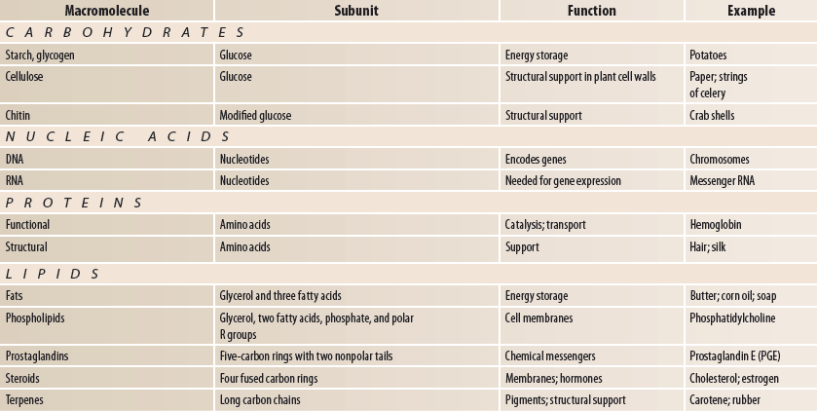

Slide 40
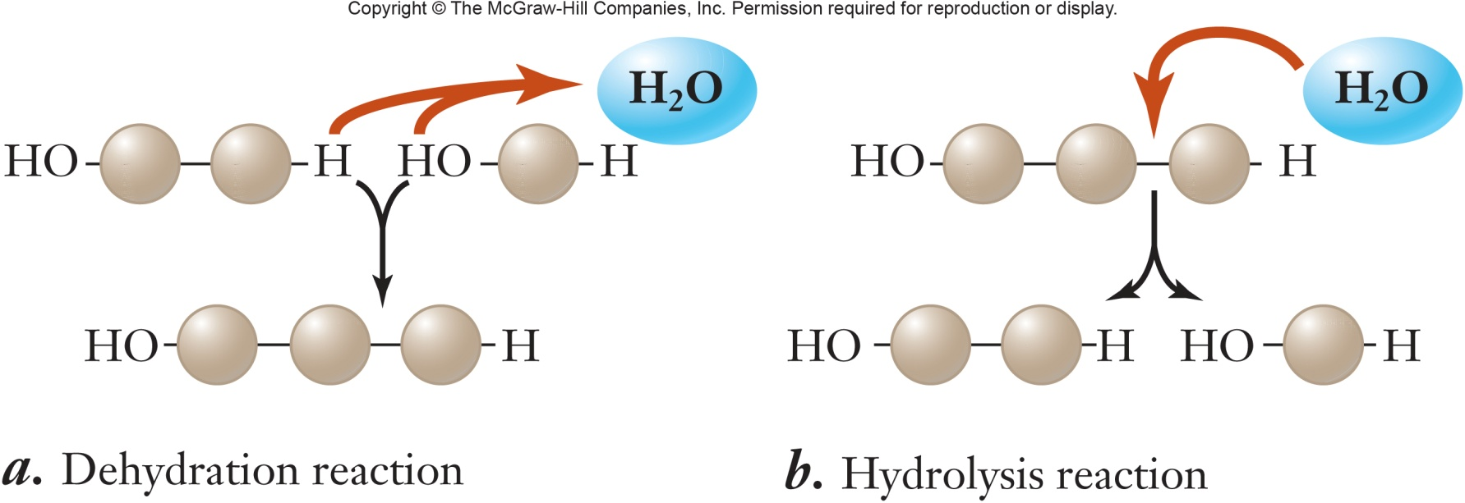
Dehydration synthesis
  Formation of large molecules by the removal of water
  Monomers are joined to form polymers
Hydrolysis
  Breakdown of large molecules by the addition of water
  Polymers are broken down to monomers

Slide 41
Carbohydrates
Carbohydrates are a loosely defined group of molecules that all contain carbon, hydrogen, and oxygen in the molar ratio 1:2:1.
Their empirical formula (which lists the number of atoms in the molecule with subscripts) is (CH2O)n, where n is the number of carbon atoms.
C—H covalent bonds hold much energy
  Carbohydrates are good energy storage molecules
  Examples: sugars, starch, glucose

Slide 42
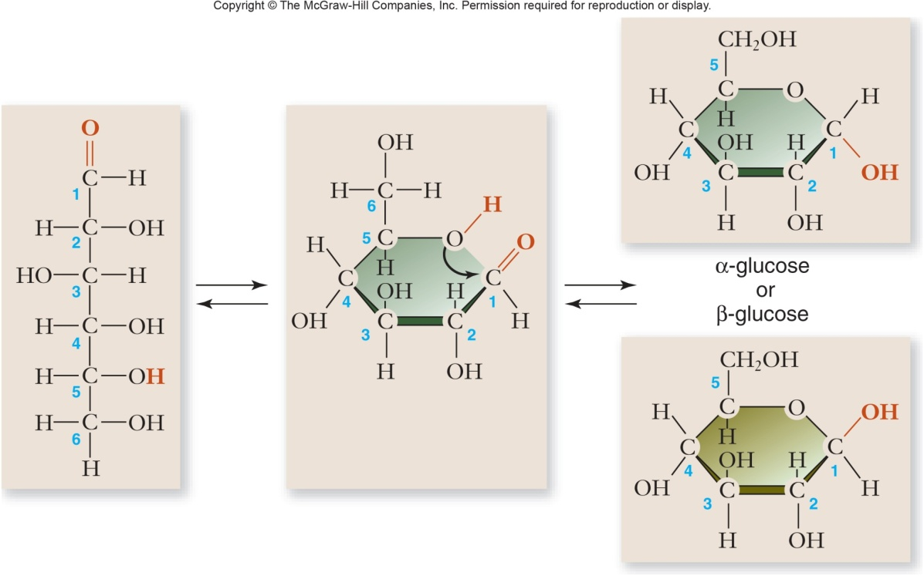
Carbohydrates
Monosaccharides
Simplest carbohydrate
6 carbon sugars play important roles
Glucose C₆H₁₂O₆

Slide 43
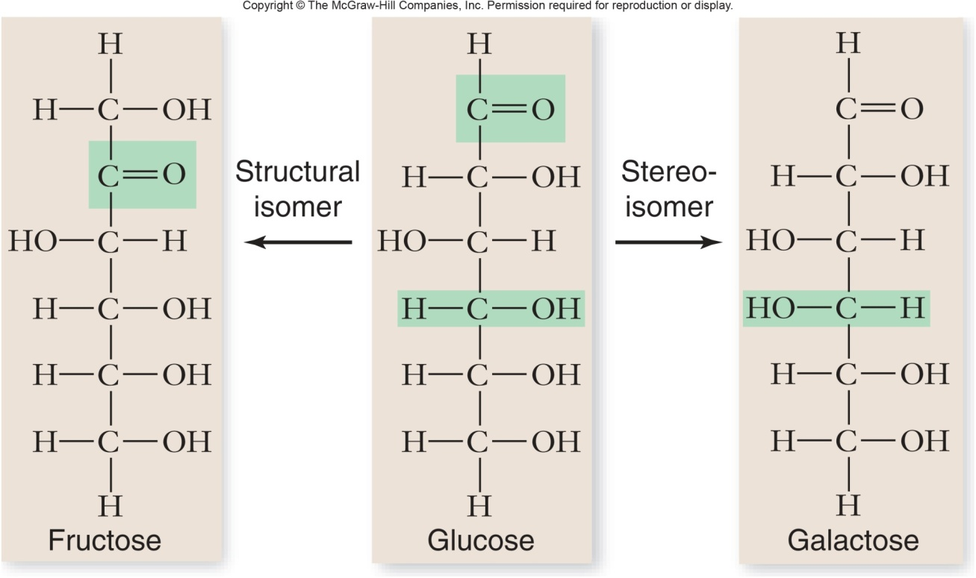
Fructose is a structural isomer of glucose
Galactose is a stereoisomer of glucose
Enzymes that act on different sugars can distinguish structural and stereoisomers of this basic six-carbon skeleton

Slide 44
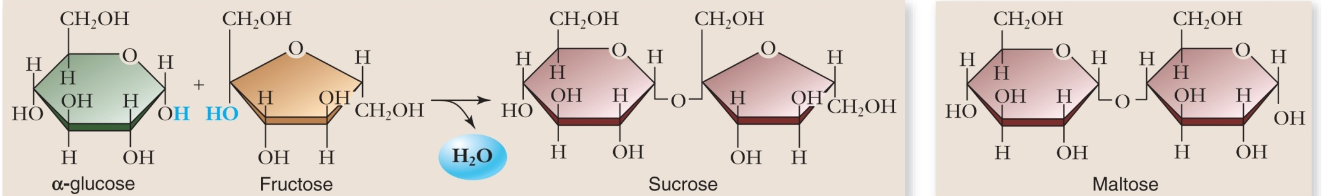
Disaccharides
2 monosaccharides linked together by dehydration synthesis
Used for sugar transport or energy storage
Examples: sucrose, lactose, maltose

Slide 45
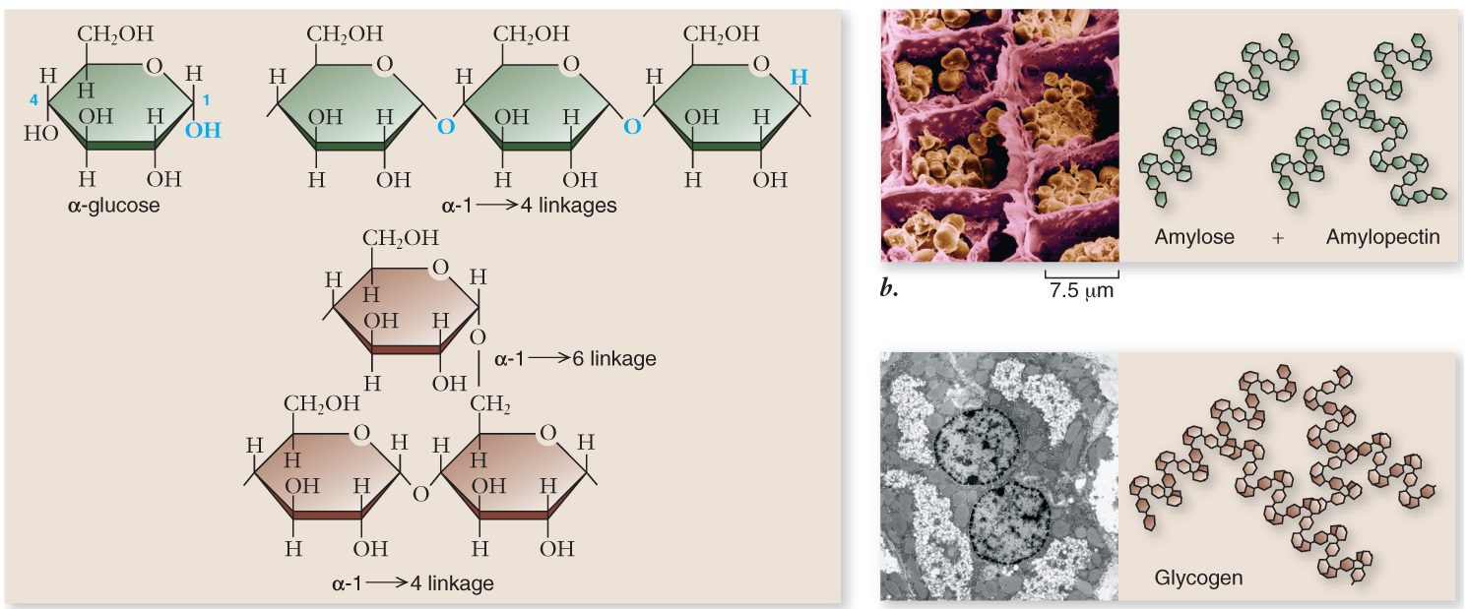
Polysaccharides
Long chains of monosaccharides
  Linked through dehydration synthesis
Energy storage
  Plants use starch
  Animals use glycogen

Slide 46
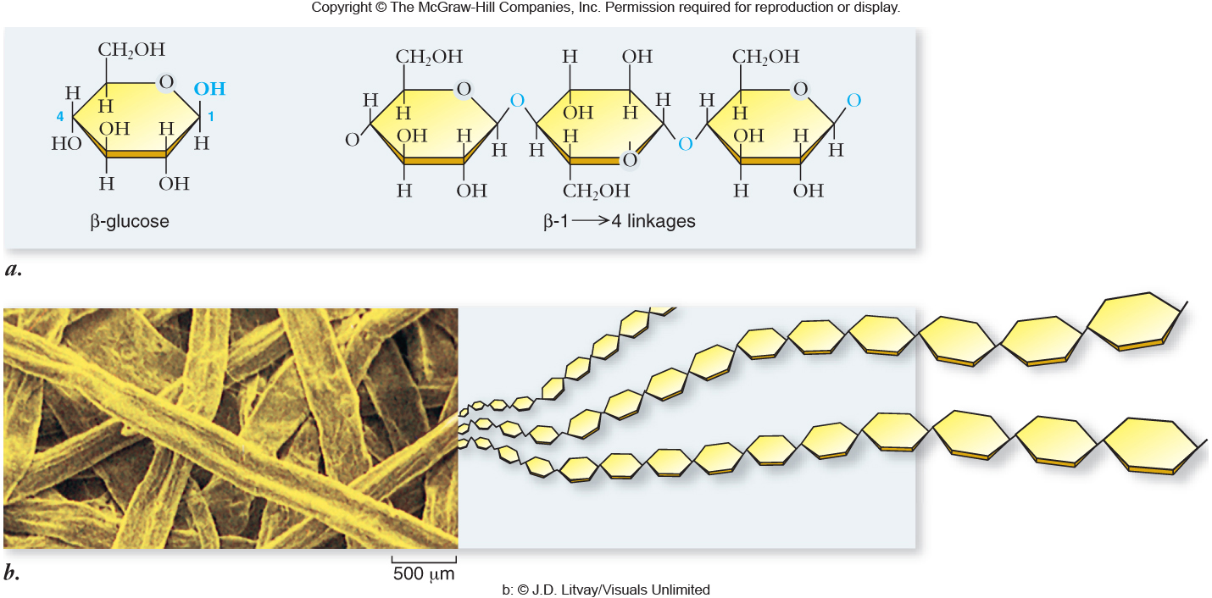
Structural support
  Plants use cellulose
  Arthropods and fungi use chitin

Slide 47
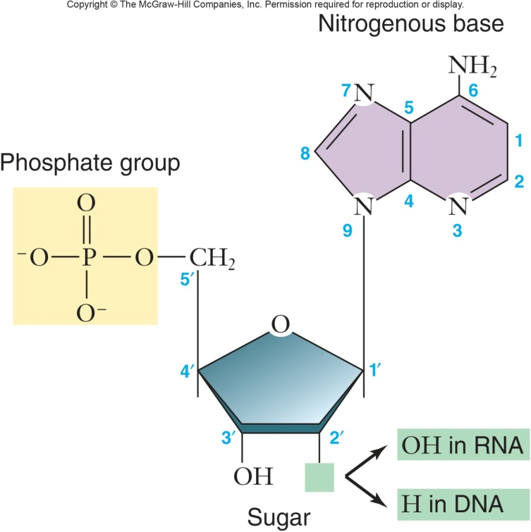
Nucleic acids
Deoxyribonucleic acid (DNA) and ribonucleic acid (RNA) are polymers composed of nucleotide monomers.
Cells use nucleic acids for information storage and transfer.
Nucleic acids are nucleotide polymers: Nucleic acids contain four different nucleotide bases. In DNA these are adenine, guanine, cytosine, and thymine. In RNA, thymine is replaced by uracil.

Slide 48
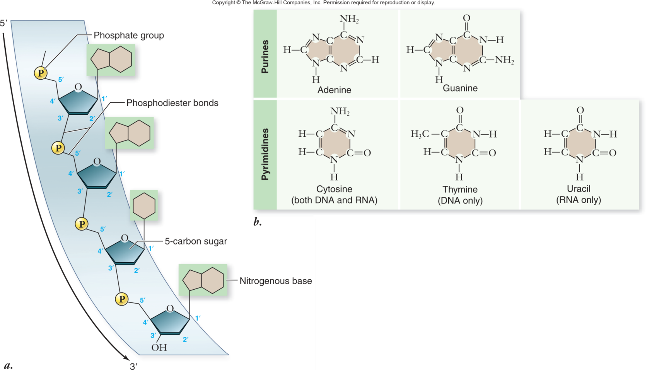
  Nitrogenous bases include
    Purines: adenine and guanine
    Pyrimidines: thymine, cytosine, uracil
  Nucleotides connected by phosphodiester bonds

Slide 49
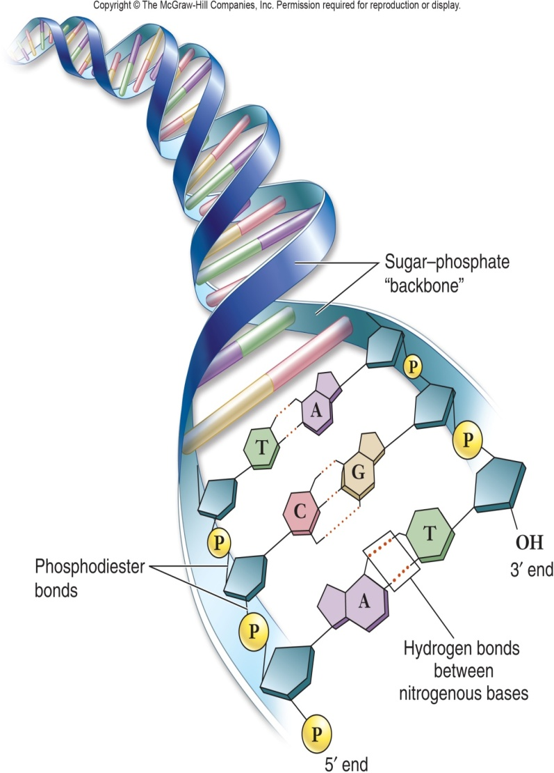
Deoxyribonucleic acid (DNA)
Encodes information for amino acid sequence of proteins
  Sequence of bases
Double helix – 2 polynucleotide strands connected by hydrogen bonds
  Base-pairing rules
    A with T (or U in RNA)
    C with G

Slide 50
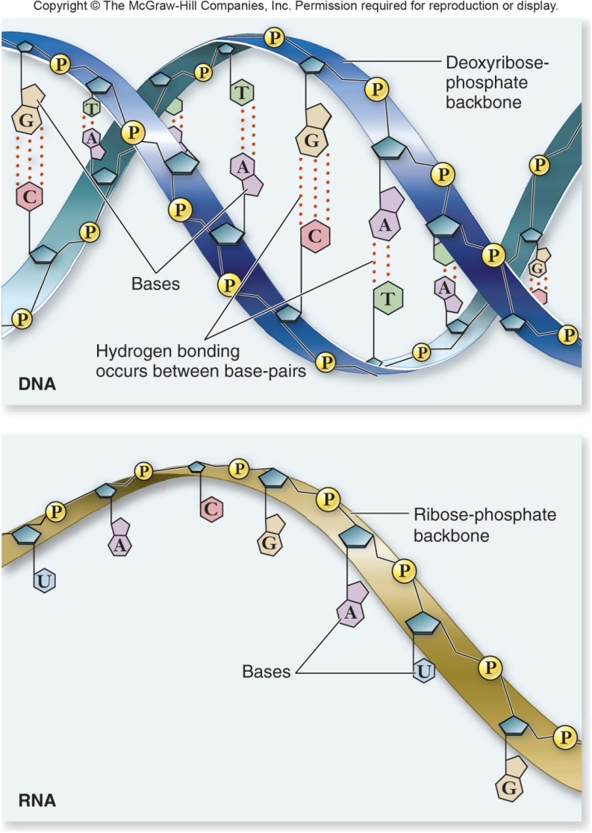
Ribonucleic acid (RNA)
RNA similar to DNA except
  Contains ribose instead of deoxyribose
  Contains uracil instead of thymine
Single polynucleotide strand
RNA uses information in DNA to specify sequence of amino acids in proteins

Slide 51
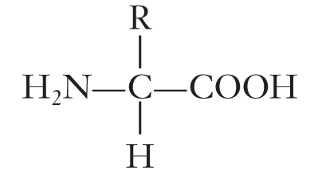
Protein
Proteins are polymers
  Composed of 1 or more long, unbranched chains
  Each chain is a polypeptide
Amino acids are monomers
Amino acid structure
  Central carbon atom
  Amino group
  Carboxyl group
  Single hydrogen
  Variable R group

Slide 52
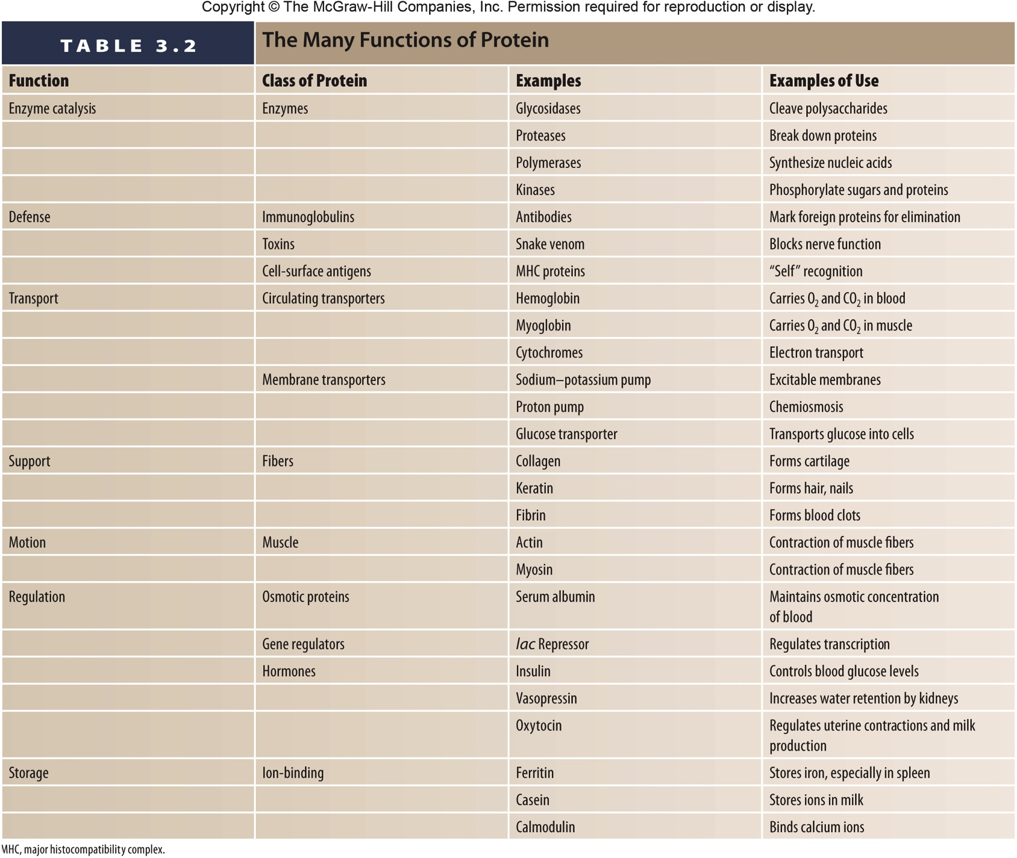
Protein
Protein functions include:

Slide 53
4 Levels of protein structure
Primary structure – sequence of amino acids (beads on a string)
Secondary structure – interaction of groups in the peptide backbone
  a helix
  b sheet
Tertiary structure – final folded shape of a globular protein
  Stabilized by a number of forces
  Final level of structure for proteins consisting of only a single polypeptide chain
Quaternary structure – arrangement of individual chains (subunits) in a protein with 2 or more polypeptide chains

Slide 54
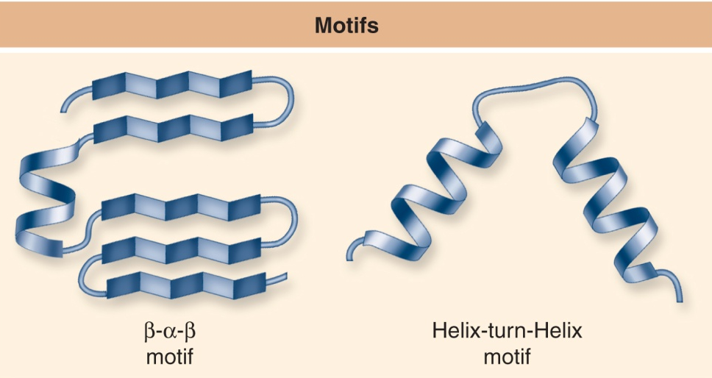
Additional structural characteristics
Motifs
  Common elements of secondary structure seen in many polypeptides
  Useful in determining the function of unknown proteins

Slide 55

Additional structural characteristics
Domains
  Functional units within a larger structure
  Most proteins made of multiple domains that perform different parts of the protein’s function

Slide 56
Chaperones
Once thought newly made proteins folded spontaneously
Chaperone proteins help protein fold correctly
Deficiencies in chaperone proteins implicated in certain diseases
  Cystic fibrosis is a hereditary disorder
    In some individuals, protein appears to have correct amino acid sequence but fails to fold

Slide 57
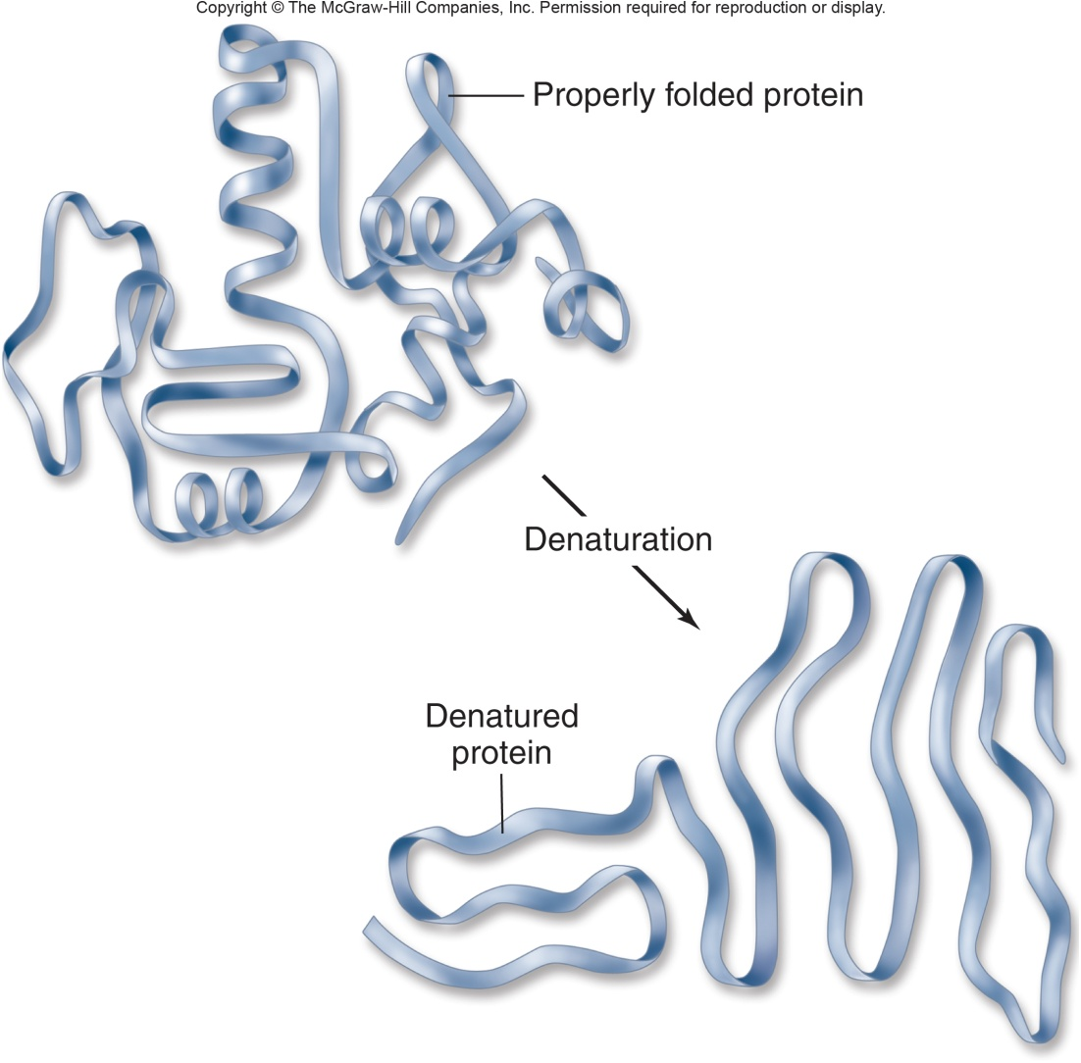
Denaturation
Protein loses structure and function
Due to environmental conditions
  pH
  Temperature
  Ionic concentration of solution

Slide 59
Lipids
Loosely defined group of molecules with one main chemical characteristic
  They are insoluble in water
High proportion of nonpolar C—H bonds causes the molecule to be hydrophobic
Fats, oils, waxes, and even some vitamins

Slide 60
Lipids
Fats
Triglycerides
  Composed of 1 glycerol and 3 fatty acids
Fatty acids
  Need not be identical
  Chain length varies
  Saturated – no double bonds between carbon atoms
    Higher melting point, animal origin
  Unsaturated – 1 or more double bonds
    Low melting point, plant origin
  Trans fats produced industrially

Slide 61
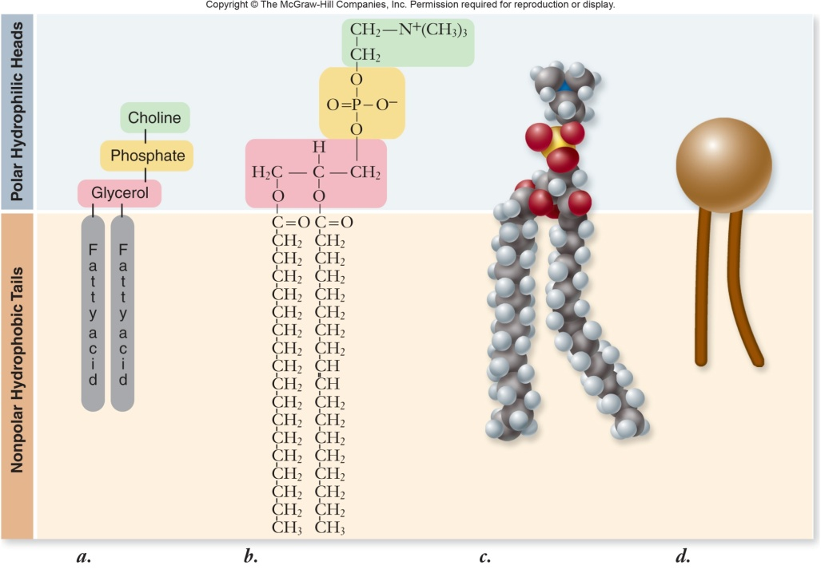
Lipids
Phospholipids
Composed of
  Glycerol
  2 fatty acids – nonpolar “tails”
  A phosphate group – polar “head”
Form all biological membranes

Slide 62
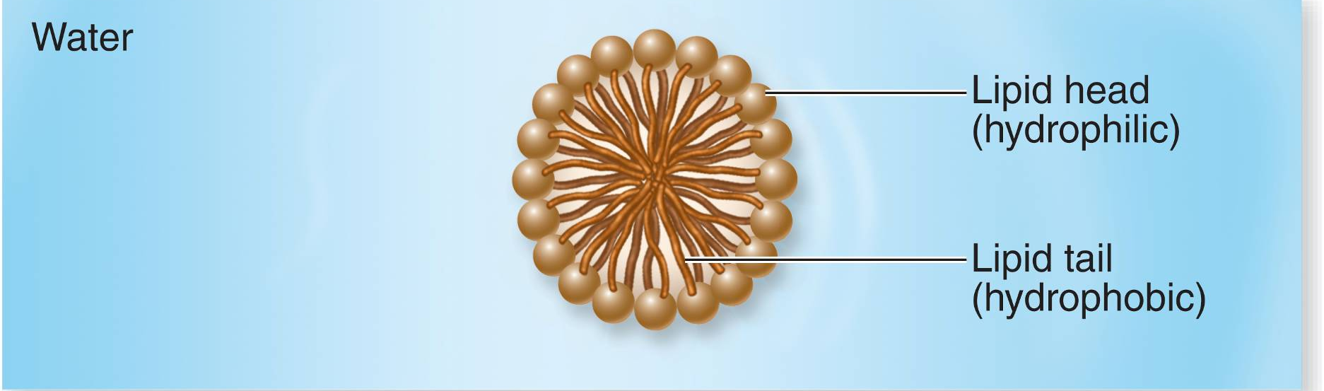
Micelles – lipid molecules orient with polar (hydrophilic) head toward water and nonpolar (hydrophobic) tails away from water

Slide 63
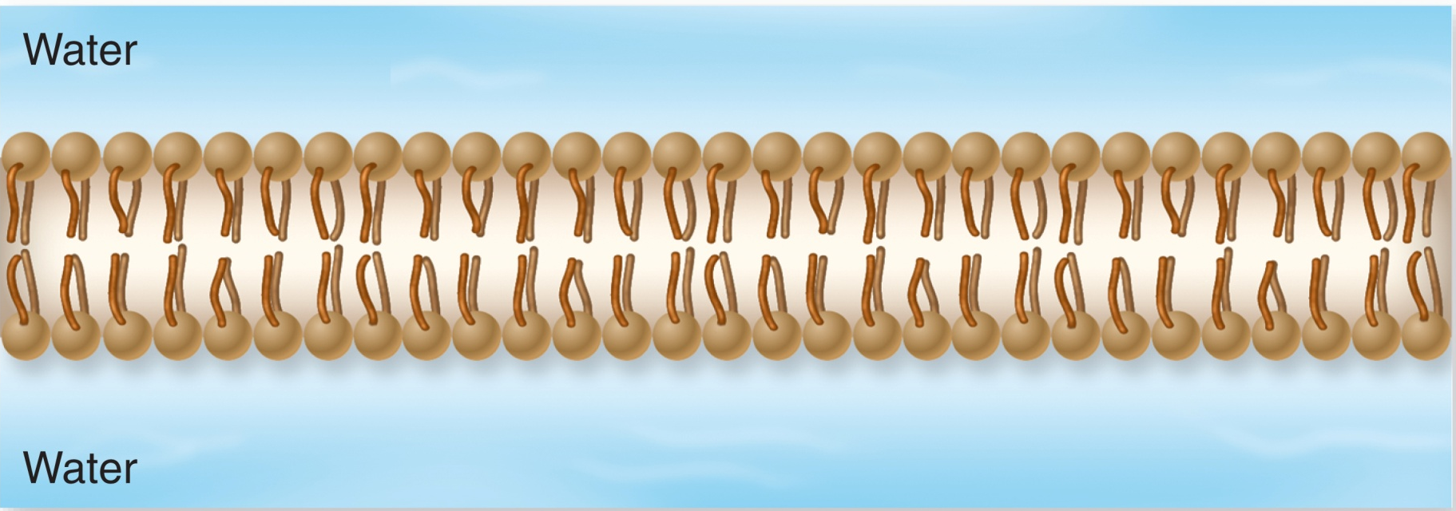
Phospholipid bilayer – more complicated structure where 2 layers form
  Hydrophilic heads point outward
  Hydrophobic tails point inward toward each other

Slide 64
References
Lisa A. Urry, Micheal L. Cain, Steven A. Wasserman, Peter V. Min. 2022. Campbell Biology 12th Edition. Pearson

